Slide 1



COMPUTER & SOFTWARE ENGINEERING DEPARTMENT
Network Intrusion Detection & Prevention System
A Practical AI-Driven Security Monitoring Pipeline
Mahmoud Ahmed Elbakry
Ahmed Hani Aldarderi
Mamoun Saeed Mohamed
200017026
200013299
200013389
Mohab Mohamed Shawky
Mohanad Malek Selim
Mohammed Essam El Dien
200013394
200010975
200011805
Supervised by: Dr. Suzan Shukry
Misr University for Science and Technology — College of Engineering

Slide 2

Project Abstract
Modern network architectures present sophisticated threat landscapes that render traditional rule-based firewalls obsolete.
Key Research Outcomes
Comparative analysis between classical ML and deep architectures.
This project introduces an advanced Network Intrusion Detection System that leverages artificial intelligence to achieve superior, adaptive detection capabilities.
Elimination of LSTM references to focus on stable ANN models.
By training on the benchmark dataset CICIDS2017, the proposed framework extracts complex characteristics automatically, significantly outperforming conventional systems.
Successful deployment of local model in a live Flask dashboard.
Generalization verified on high-speed network traffic data.

Slide 3












Presentation Agenda
Foundations & Core Comparison
Classical ML Track
Deep Learning (DL) Track
NIDPS introduction, core security limits, and the direct ML vs. DL architectural contrast.
Feature scaling, dimensionality reduction, stratified downsampling, and classical algorithm results.
ANN dense model deployment, standardized Z-scaling logic, metrics, and false alarm evaluations.
Literature Benchmarking
Attack Taxonomy & Lab Setup
Software Live Deployment
Comparing our ML & DL performance with Zhang, Halbouni, Nawaz, and Zhao et al.
Technical workflows of 7 attack categories and isolated laboratory environment details.
Five-step pipeline demonstration, Flask dashboard UI, and future enhancements.

Slide 4
Section 1: Introduction & Fundamentals
The cyber threat landscape, limitations of signature-based defenses, and security paradigm alignment.

Slide 5


The Modern Cyber Threat Landscape
Digital transformation relies heavily on large-scale network infrastructures carrying crucial enterprise data.
The rapid growth of networks makes digital communication an essential foundation of modern organizations, universities, and financial services.
Massive Scale
High Speed
Billions of devices generate packet data.
Gigabit links carry millions of flows.
Protecting the confidentiality, integrity, and availability (CIA) of transmitted traffic has become a critical operational requirement.

Slide 6

Traditional Defense Limitations
Signature Blindness
High False Positives
Static Rules
Standard IDS solutions only recognize known attack patterns. They fail to identify slightly modified or zero-day exploits.
Frequent false alarms overwhelm network administrators, causing critical warnings to be missed in the noise.
Manual rule configuration is slow, expensive, and cannot easily adapt to changing enterprise topologies.

Slide 7
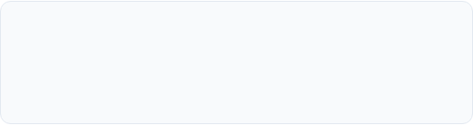
Why AI is the Answer
Dynamic Generalization
Instead of matching exact strings, AI models learn the statistical profile of normal behavior—allowing them to flag novel anomalies.
Processes high-dimensional flow statistics.
Autonomous Feature Analysis
Operates at high speed after training.
Moving from handcrafted network rules to statistical algorithms that capture subtle deviations across multiple headers.
Provides adaptive protection against polymorphic threats.

Slide 8

The CIA Triad Alignment
Confidentiality
Integrity
Availability
Ensuring data is not exposed to unauthorized entities.
Preventing unauthorized modifications of systems and traffic.
Ensuring resources remain accessible to authorized users.
Threatened by: Infiltration & Heartbleed
Threatened by: Web Attacks & Backdoors
Threatened by: DoS & DDoS Attacks

Slide 9
Section 2: ML vs. DL Comparison
Evaluating feature representations, computational requirements, and accuracy ceilings in high-dimensional flow environments.

Slide 10
Machine Learning vs. Deep Learning
Characteristic | Machine Learning (ML) | Deep Learning (DL)
Feature Engineering | Manual (requires expert selection of parameters) | Automatic (features extracted dynamically through layers)
Computational Load | Low training time; fast execution on standard CPU | High training resource consumption; benefits from GPUs
Data Requirements | Performs well on smaller datasets | Needs large datasets to be effective
Accuracy Ceiling | Plateaus once features are exhausted | Keeps improving as more data is added
Best At | Clear, well-separated class boundaries | Subtle, high-dimensional, nonlinear patterns
Features Used | 16 manually selected flow-level features (TCP flags, packet lengths, flow rates — real-time extractable) | 68 full cleaned columns (automatic weight selection via backpropagation — no manual engineering)

Slide 11


Architectural Representation Contrast
Classical ML Representation
Deep Learning Auto-Extraction
Relies heavily on manual feature extraction. Domain experts must analyze packet sizes and select discriminative indices offline.
Features are fed into stacked feed-forward dense layers. Lower hidden layers learn simple linear variances, while deeper layers automatically synthesize complex, high-dimensional nonlinear relationships.
The selected features are passed as static fields to simple shallow estimators, limiting behavioral pattern modeling.
Eliminates manual bias, allowing the detector to capture subtle variations hidden in traffic timing and multi-packet header structures.

Slide 12
Feature Selection & Importance Analysis — ML vs DL
16
68
ML Track features (selected from 80 total)
DL Track features (full cleaned set, auto-weighted)
How ML Features Were Selected
How DL Features Were Selected
① Domain filtering
① Keep all 80 columns
From 80 CICFlowMeter columns, features requiring deep packet inspection or unavailable at runtime were removed, leaving 30 candidates.
All 80 columns retained after removing NaN/Inf rows (CICFlowMeter division-by-zero artifacts), leaving 68 fully numeric columns.
② XGBoost gain-based ranking
② ANN learns weights automatically
XGBoost trained on 30 candidates; each feature scored by average loss reduction per split across 200 trees. Top 16 retained. PSH Flag Count = 24.21% of total gain.
No manual selection. Dense(256) input layer adjusts weights via backpropagation. Dropout (0.2–0.3) suppresses low-signal features automatically.
③ Validation
③ Key difference from ML
16-feature model → 97.99% accuracy. 80% dimensionality reduction at zero accuracy cost.
ML: 16 features for real-time hardware extraction. DL: 68 features proving deep networks need no manual engineering — a core project finding.

Slide 13
Section 3: Classical Machine Learning Track
A parallel detection pipeline focused on multi-class typing, class rebalancing, and execution efficiency.

Slide 14
ML Preprocessing & Data Cleaning
Handling Packet Anomaly Flaws
Original traffic exports contain invalid values resulting from division-by-zero errors (e.g. packet rates on zero flow duration).
Pipeline Consistency
Preprocessing acts as a gatekeeper. By dropping corrupted lines in the training data, the model avoids gradient explosion and mathematical weight instability.
Aggressive removal of NaN records.
Purging of all Infinite values.
Ensuring 100% clean numerical feature representations.
The same clean parameters are locked to ensure stable runtime operation.

Slide 15

ML Pipeline: Features & Class Balancing
Dimensionality Reduction
Stratified Downsampling
To optimize hardware usage in high-speed settings, the feature space was aggressively reduced from 80 to 16 critical features.
Network traffic datasets suffer from extreme class imbalances (normal traffic vastly outnumbers attacks).
This feature pruning achieved a 80% reduction in computing overhead while maintaining excellent discriminative power.
We applied stratified downsampling — capping BENIGN at 200,000 and attack classes at 80,000 — to balance class distribution without introducing synthetic data bias.

Slide 16
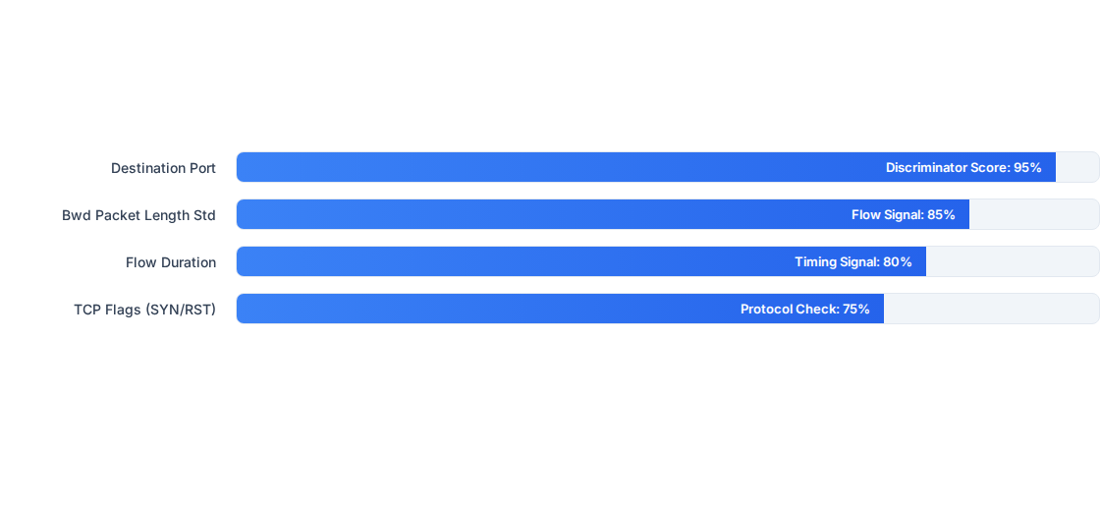
Key Discriminant Features in Classical ML
Feature importance derived from our trained XGBoost model using gain-based scoring (average loss reduction per split).

Slide 17
Feature Importance — Measurement & Selection Rationale
How Feature Importance Is Measured
Top 8 Features — XGBoost Gain Scores
XGBoost Gain-Based Scoring
#
Gain
Feature / Attack Relevance
Each feature receives a gain score = average reduction in training loss per split, across all 200 boosting trees. Higher gain = more predictive value per use — more reliable than frequency counts which simply measure how often a feature appears.
1
0.2421
PSH Flag Count
HTTP floods bypass TCP buffering
2
0.1798
Bwd Packet Length Min
Scanning vs normal traffic
3
0.1109
Total Fwd Packets
Asymmetric ratio → DoS/DDoS
Why These 16 Features?
4
0.0913
Total Length of Bwd Packets
Bulk exfiltration responses
All 16 are directly extractable from live TCP/IP headers by CICFlowMeter — no deep packet inspection required. PSH Flag Count alone accounts for 24.21% of total predictive gain.
5
0.0687
Total Length of Fwd Packets
Payload flooding
Performance Impact
6
0.0602
Fwd Packet Length Max
Fixed-payload tool traffic
97.99% overall accuracy using only 16 of 80 features — confirming that an 80% dimensionality reduction introduced zero accuracy cost.
7
0.0593
Bwd Packet Length Max
Amplification attacks
8
0.0415
Total Backward Packets
Server unresponsive under DoS
Gain vs Frequency Importance
Gain is preferred over frequency because a feature used in 1 critical split that perfectly separates DDoS from BENIGN outranks a feature used in 100 low-value splits.

Slide 18



Classical ML Model Configurations
Random Forest
XGBoost
k-NN
Parameters: 100 Trees; Criterion: Gini; Max Depth: Uncapped.
Parameters: 200 boosting rounds; Learning rate: 0.1; Max Depth: 8.
Parameters: k=5 Neighbors; Metric: Euclidean Minkowski distance.
Ensures strong multi-class ensemble voting by combining weak decision splits.
Uses sequential corrective gradient trees to optimize memory constraints.
Calculates nearest distance neighbors. Computationally slow for production.

Slide 19
Classical Algorithm Metrics (8-Class)
Algorithm | Task Target | Test Accuracy | Notable Multi-Class Strengths
Random Forest (RF) | 8-Class Tabular | 95.81% | Highest Botnet recall (98.64%); strong DDoS (99.88%) and FTP-Patator (99.79%)
XGBoost (Winning Prototype) | 8-Class Tabular | 97.99% | Best overall accuracy; top scores on DDoS (99.87%) and PortScan (99.96%)
k-Nearest Neighbors (k-NN) | 8-Class Tabular | 97.69% | Highly accurate local decisions, but slow execution

Slide 20
Computational Efficiency Analysis
Resource consumption of the parallel multi-class algorithms during local training and evaluation:
Model | Execution Time | RAM Consumed | CPU Usage
Random Forest (RF) | 15.2s | 4,059.66 MB | 26.71%
XGBoost (Winner) | 12.2s | 1,355.11 MB | 24.62%
k-Nearest Neighbors (k-NN) | 51.8s | 1,409.50 MB | 9.02%

Slide 21

XGBoost: The Winning Classical Prototype
Superior Speed and Weight Optimization
XGBoost achieves the best overall accuracy (97.99%) across all three models while using the least computational resources.
Verdict for Production Deployment
In high-throughput corporate environments, execution speed is as critical as accuracy.
1.25x faster execution time than Random Forest.
Consumes only 1.3 GB of RAM, ensuring lightweight edge capability.
XGBoost represents the optimal choice for classical multi-class deployment.
Best overall accuracy (97.99%); top scores on DDoS (99.87%) and PortScan (99.96%).

Slide 22











Multi-Class Decision Targets
Normal Traffic
Volumetric Attacks
Administrative Abuse
Baseline benign network sessions representing normal authorized operations.
DoS and DDoS flows mapped through high byte/packet rate features.
SSH/FTP Brute Force credential probing containing uniform connection resets.
Web Applications
Stealth Campaigns
Exploits
HTTP-based exploits, XSS, and SQL Injection targeting open web endpoints.
Infiltration and Botnet activity characterized by custom command-and-control beacon timers.
Specialized buffer leaks such as Heartbleed utilizing abnormal asymmetric segment lengths.

Slide 23
Section 4: Deep Learning Track
Designing, implementing, and validating the 5-dense layer neural network for high-throughput binary threat detection.

Slide 24

DL Pipeline: Cleaning & Binary Labeling
Flow Parsing & Cleaning
Binary Output Design
Original traffic exports contain invalid values resulting from division-by-zero errors (e.g. packets/sec when flow duration equals zero).
We folded all attack categories into a single unified binary classification target:
All rows containing NaN or Infinite floating points were purged, retaining exactly 68 clean numerical columns.
• Class 0 (BENIGN): Legitimate daily transactions.
• Class 1 (ATTACK): Synthesizes DoS, DDoS, Brute Force, Infiltration, Botnet, Heartbleed, and Web Threats.

Slide 25

Deployed ANN Architecture
Input Layer
5 Dense Layers
Sigmoid Output
68 neurons representing standard preprocessed flow attributes. Features are scaled using standard normalization parameters.
Hidden node distribution: 256, 128, 64, and 32 neurons. Uses ReLU activations for nonlinear pattern extraction.
A single sigmoid neuron outputting a binary probability score between 0 and 1, mapping to BENIGN or ATTACK.

Slide 26
ANN Dense Network Specifications
Layer Name | Type / Architecture Specifications | Activation | Regularization Details
Input Block | 68 Neurons (numerical flow vector) | Linear | Z-score standard normalization (StandardScaler)
Dense 1 | 256 Neurons (fully connected) | ReLU | Batch Normalization + Dropout (rate = 0.3)
Dense 2 | 128 Neurons (fully connected) | ReLU | Batch Normalization + Dropout (rate = 0.3)
Dense 3 | 64 Neurons (fully connected) | ReLU | Batch Normalization + Dropout (rate = 0.2)
Dense 4 | 32 Neurons (fully connected) | ReLU | Dropout (rate = 0.2)
Output Block | 1 Sigmoid Neuron (binary decision mapping) | Sigmoid | Final classification threshold locked at 0.5

Slide 27

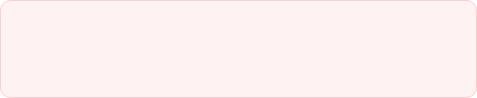
Deep Learning Performance Results
96.45%
Baseline ANN & ROC-AUC Performance
Baseline ANN Test Accuracy
• Baseline ANN model: Achieved 96.45% accuracy on the test set, demonstrating robust binary detection performance.
99.49%
• ROC-AUC: 0.9949 (99.49%) — model ranks a random attack above a random benign flow 99.49% of the time, demonstrating near-perfect discrimination.
ROC-AUC Score

Slide 28
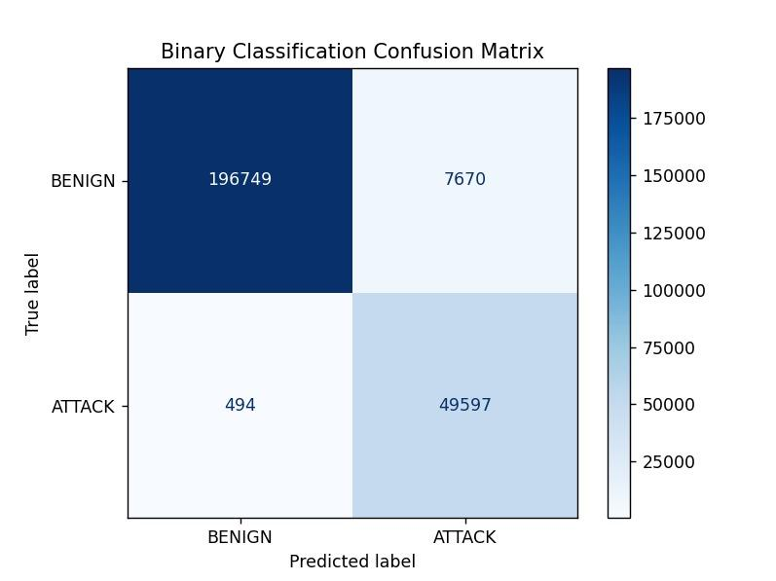
ANN Confusion Matrix
Class | Predicted BENIGN | Predicted ATTACK | Class Performance Metrics
Actual BENIGN | 198,219 (TN) | 6,200 (FP) | FP Rate: 3.03%
Actual ATTACK | 2,826 (FN) | 47,265 (TP) | FN Rate (Miss Rate): 5.64%
Evaluating the deployed baseline ANN performance over 254,510 test records at a threshold of 0.5:

Slide 29


False Positive & False Negative Analysis
6,200 False Positives (3.03%)
2,826 False Negatives (5.64%)
Cause: High-volume legitimate traffic (file transfers, cloud backups) shares statistical packet/timing signatures with DoS flows.
Cause: Low-signature, highly stealthy attacks (e.g. slow brute force, infiltration) resembling standard user actions.
Impact: Contributes to SOC alert fatigue, requiring optimized routing filters to reduce false alerts.
Impact: Represents critical perimeters missed, highlighting the need for secondary host-based defenses.

Slide 30
Section 5: Literature Review & Benchmarking
Evaluating our system's direction against the foundational literature that shaped state-of-the-art flow classification.

Slide 31


Literature Focus: Classical ML Track
Jairu [1] (2021 SCSU Thesis)
Zhang et al. [14] (2021)
Evaluated classical ML models (RF, SVM, KNN, Naive Bayes) on the CICIDS2017 dataset.
Developed a hybrid approach using a Stacked Autoencoder (SAE) for feature reduction, followed by Random Forest classification.
Key Result: Random Forest achieved 99.93% accuracy using a subset of 14 selected features.
Key Result: Achieved 99.92% accuracy on multi-class typing.
Proven feature compression concept that guided our 16-feature dimensionality selection.
Highly accurate but lacked a runtime deployment dashboard for continuous flow validation.

Slide 32
Literature Focus: Deep Learning Track
Zhao et al. [2] (2023 TBGD)
Nawaz et al. [15] (2023)
Proposed the TBGD model, combining Transformers, BiGRUs, and DNN layers for multi-class classification.
Ran 9-class CICIDS2017 evaluations with SMOTE-balanced recurrent models.
Used custom oversampling (RUSK) to manage imbalanced minority categories.
Key Result: Obtained 98.67% accuracy with their hybrid model.
Confirmed that minority-class F1 improves significantly under oversampling pipelines.
A complex deep architecture proving the power of automatic feature extraction over manual methods.

Slide 33
Literature Benchmarking Comparison
Published Study | Approach / Model Used | Reported Metrics | Task Scope
Halbouni et al. (2022) | Hybrid CNN-LSTM | 94.70% Precision | Binary Classification
Zhang et al. (2021) | Stacked Autoencoder + RF | 99.92% Accuracy | Multi-Class Classification
Nawaz et al. (2023) | CNN + LSTM (SMOTE) | 98.67% Accuracy | 9-Class Multiclass Classification
Our Project (ANN Binary) | Optimized ANN (5-Dense Layers) | 96.45% Accuracy | Binary Deployed Pipeline

Slide 34
Per-Class Multi-Class Benchmark Details
Headline accuracy hides class-level failure. Here we line up Nawaz et al.’s per-class test results against our classical ML multi-class numbers:
Source Study | Target Class | Class Performance Metrics | Target Threat Characteristics
Nawaz et al. (2023) | SSH / FTP Brute Force | F1-Score: 0.92 | Solid recall, but high false positive rate
Our Classical Track | DDoS & Brute Force | F1-Score: 0.99 (P/R: 0.99) | Perfect precision and recall; no false alarms
Nawaz et al. (2023) | Botnet Class | F1-Score: 0.58 (Precision: 0.41) | Precision collapsed even with Focal Loss rebalancing
Our Classical Track | Botnet Class | Recall: 98.64% (RF) / 61.67% (XGBoost) | RF leads on Botnet; XGBoost wins overall accuracy via 16 selected features

Slide 35
Section 6: Attack Taxonomy & Lab Setup
Technical workflows, target signatures, and the virtual VMware laboratory environment used for validation.

Slide 36


Attacks 1 & 2: DoS & DDoS Flooding
Denial of Service (DoS)
Distributed DoS (DDoS)
Mechanism: A single attacker node exhausts server socket buffers or CPU resources to prevent access.
Mechanism: Coordinated flooding from thousands of distributed botnet nodes simultaneously.
Flow Signature: Flow IAT Std drops significantly; Fwd Packets/s rises.
Flow Signature: Extreme inbound Flow Bytes/s spike, accompanied by high source IP entropy.
Lab Evidence: Executed via hping3 against Metasploitable targets; triggered instant CPU exhaustion.
Lab Evidence: Multi-VM coordinated HTTP flood; logged via Wireshark on the gateway bridge.

Slide 37

Attacks 3 & 4: Brute Force & Infiltration
SSH/FTP Brute Force
Infiltration Campaigns
Mechanism: Automated dictionary tools systematically attempt to authenticate against standard administrative ports (21, 22).
Mechanism: Vulnerability exploitation to establish a backdoor command shell, followed by lateral pivot movement.
Flow Signature: Highly repetitive, short Flow Duration connections with reset headers.
Flow Signature: Asymmetric Packet Length Std representing interactive terminal traffic.
Lab Evidence: Executed using Hydra, triggering sequential failed authentication logs on target VMs.
Lab Evidence: Metasploit payload delivery; established persistent crontab listener scripts on the victim host.

Slide 38
Attacks 5 & 6: Botnet & Heartbleed
Botnet Activity
Heartbleed Exploit (CVE-2014-0160)
Mechanism: Infected internal machines communicate periodically with an external Command and Control (C&C) server.
Mechanism: OpenSSL heartbeat length bounds check failure, allowing attackers to read private server memory buffers.
Flow Signature: Highly uniform Flow IAT Mean representing strict timer beacon checks.
Flow Signature: Asymmetric response size with unusually large Bwd Packet Length Mean.
Lab Evidence: Multiple local agents communicating with a central Kali Linux handler VM.
Lab Evidence: Exploited via Metasploit, successfully retrieving mock token flag: THM{sSl-Is-BaD}.

Slide 39
The Laboratory Security Setup
Isolated Sandbox
Target OS Targets
Traffic Sniffer VM
VMware workstation virtualization using private host-only virtual adapters to isolate attack scripts.
Metasploitable 2 & Metasploitable 3 running as insecure servers to test exploitable threats.
Dedicated routing node running Wireshark to inspect flow timing, TCP markers, and output captures.

Slide 40
Section 7: Integrated Software Deployment
A Practical Runtime Pipeline: Preprocessing, Saved Scaler Integration, and the Live Flask Dashboard Demonstration.

Slide 41




The Five-Step Runtime Pipeline
1. Raw Dataset
2. Preprocessing
3. Standard Scaling
4. Model Inference
5. Live Dashboard
Acquiring flow metrics from benchmark files.
Deduplicating, removing NaNs, and splitting arrays.
Applying the training scaler parameters to test inputs.
Loading the H5 model file to generate binary probability.
Displaying results and metrics in a Flask web UI.

Slide 42


Prediction & Confidence Logic
Binary Output Threshold (0.5)
Confidence Mapping Formulas
The final sigmoid output represents a probability range. We map the classification score as follows:
To ensure the dashboard displays a clear percentage confidence score to security analysts:
• Output ≥ 0.5: Classified as ATTACK.
• For Attack predictions: Score * 100
• Output < 0.5: Classified as BENIGN.
• For Benign predictions: (1 - Score) * 100

Slide 43

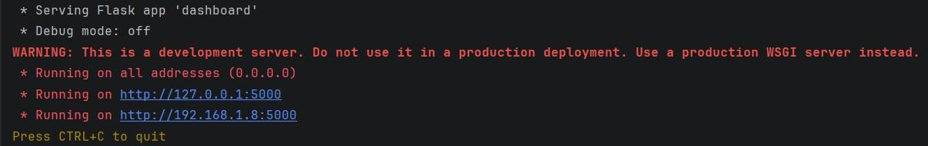
The Flask Dashboard Interface
Real-Time Security Event Logging
The frontend interface converts complex model outputs into an actionable console for SOC administrators.
Tracks Total Alert triggers dynamically.
Demonstration Transparency
Identifies anomalous traffic with clear color-coded statuses.
The dashboard is fully runnable locally, connecting the exported Keras network weights file to the active browser views via a clean Flask backend routing structure.
Displays source/destination IP tags derived from sample metadata.
Monitors model confidence levels for every transaction.

Slide 44

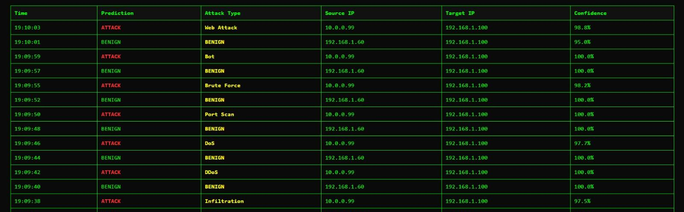
dashboard
Live Detection & Dashboard Interface
settings_input_component
Stream Parsing
Processes sequential packet headers to simulate real-time live input flows.
palette
Color Classification
Isolates ATTACK malicious activity from normal BENIGN flows.
analytics
Telemetry Counter
Running dashboard events track alerts (showing 82 alerts) dynamically.
B.Sc. Final Year Project — Live Demonstration Module
Active Execution State

Slide 45

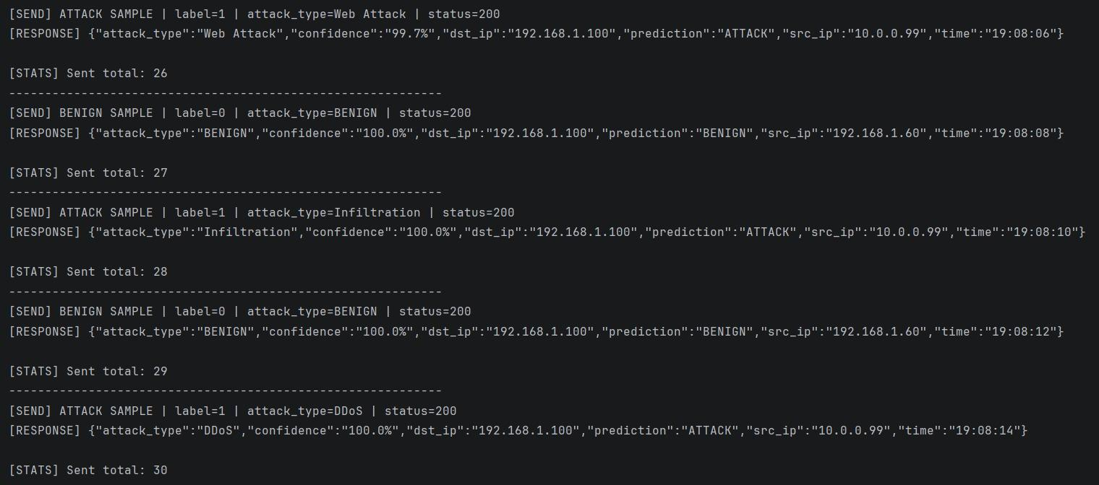
Live Sender Stream Simulation
The ips_live.py Pipeline
Validation Integrity
Simulates active production traffic by reading directly from dl_x_test_final.csv.
Avoids the standard testing trap of feeding synthetic, random variables to the interface.
Fires a continuous, sequential loop of formatted requests containing all 68 required network flow features.
Verifies that the deployed model performs inference on real benchmark traffic distributions.

Slide 46
Section 8: Conclusion & Recommendations
Summarizing key system achievements, honest prototype boundaries, and future enterprise development paths.

Slide 47
Project Accomplishments
96.45% Baseline
Consistent Scaling
Integrated Software
Achieved outstanding binary classification performance on high-dimensional benchmark datasets.
Saved preprocessing model states (.pkl) to guarantee 100% mathematical integrity during inference.
Successfully combined trained Keras weights with a real-time, browser-accessible Flask console.
Conclusion Slide 50 of 53

Slide 48
Honest Prototype Limitations
Addressing Technical Boundaries
As a graduation project, defining the boundaries of our current prototype is essential for academic transparency.
Why This Scope Matters
Simulation Basis: Relies on CSV streams rather than active inline raw packet sniffs.
Intrusion prevention requires exceptionally high confidence and low false-negative ratios before executing firewall modifications.
Binary Core: Deployed model classifies benign vs. attack; it does not perform native multi-class isolation.
Validating the detection and scaling pipeline represents the necessary first stage of system architecture.
No Blocking Logic: Focuses purely on detection and alert visualizations; inline prevention is left as future work.
System Boundaries Slide 51 of 53

Slide 49
B.SC. FINAL YEAR PROJECT — GRADUATION DEFENSE
Thank You
Questions & Academic Discussion
Computer and Software Engineering Department
Misr University for Science and Technology
MUST — Q&A Stage Slide 53 of 53

